Slide 1

Chapter 5 Functions

Slide 2
Objectives
To create functions, invoke functions, and pass arguments to a function (§5.2-5.4).
To understand the differences between pass-by-value and pass-by-reference (§§5.5-5.6).
To use function overloading and understand ambiguous overloading (§5.7).
To use function prototypes for declaring function headers (§5.8).
To know how to use default arguments (§5.9).
To create header files for reusing functions (§5.11).
To determine the scope of local and global variables (§5.13).
To develop applications using the C++ mathematical functions (§5.14).
To design and implement functions using stepwise refinement (§5.15).
(Optional) To improve runtime efficiency using inline functions (§5.16).

Slide 3
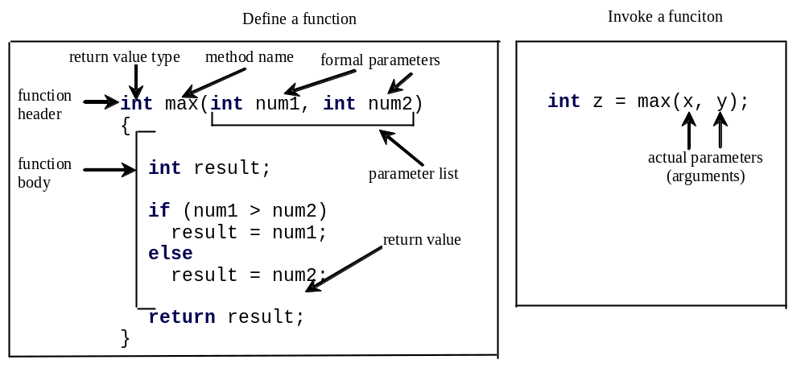
Introducing Functions
A function is a collection of statements that are grouped together to perform an operation. For example, when you call the pow(a,b), the system actually executes several statements in order to return the result.
Notes:
Function is a basic type of module.
A function to find which of two integers is bigger.
The definition of function means implementing an operation or a sequence of operations using some statements. The invoke of function means using the function.
Formal parameters are defined in the function header. Actual parameters are defined in the calling function.

Slide 4
Introducing Functions, cont.
A function declaration consists of a function header and a function body.
The function header specifies the return value type, function name, and parameters of the function.
The function body contains a collection of statements that define what the function does.

Slide 5
Introducing Functions, cont.
The variables defined in the function header are known as formal parameters.
When a function is invoked, you pass a value to the parameter. This value is referred to as actual parameter or argument.

Slide 6
Introducing Functions, cont.
A Function may return a value. The returnValueType is the data type of the value the function returns. If the function does not return a value, the returnValueType is the keyword void.

Slide 7
Calling Functions
Listing 5.1 Testing the max Function
This program demonstrates calling a Function max to return the largest of the int values
TestMax

Slide 8
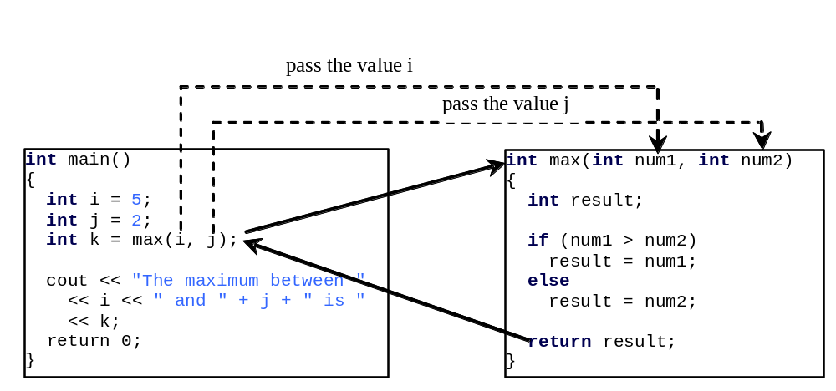
Calling Functions, cont.
animation
When a program calls a function, program control is transferred to the called function. A called function returns control to the caller when its return statement is executed or when its function ending closing brace is reached.
Notes:
When the max function is invoked, the flow of control transfers to the max function. Once the max function is finished, it returns the control back to the caller.

Slide 9
Trace Function Invocation
animation
i is now 5

Slide 10
Trace Function Invocation
animation
j is now 2

Slide 11
Trace Function Invocation
animation
invoke max(i, j)

Slide 12
Trace Function Invocation
animation
invoke max(i, j)
Pass the value of i to num1
Pass the value of j to num2

Slide 13
Trace Function Invocation
animation
declare variable result

Slide 14
Trace Function Invocation
animation
(num1 > num2) is true since num1 is 5 and num2 is 2

Slide 15
Trace Function Invocation
animation
result is now 5

Slide 16
Trace Function Invocation
animation
return result, which is 5

Slide 17
Trace Function Invocation
animation
return max(i, j) and assign the return value to k

Slide 18
Trace Function Invocation
animation
Execute the print statement

Slide 19
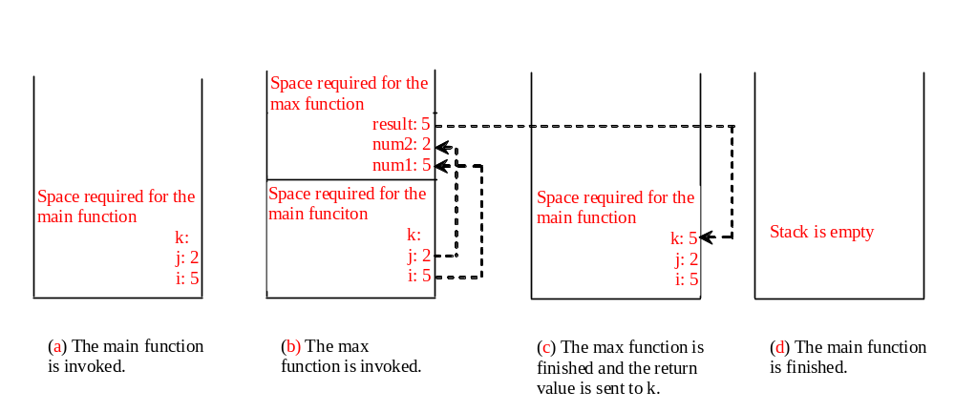
Call Stacks
Each time a function is invoked, the system stores its arguments and variables in an area of memory, known as a stack, which stores elements in last-in-first-out fashion. When a function calls another function, the caller’s stack space is kept intact and new space is created to handle the new function call. When a function finishes its work and returns to its caller, its associated space is released.
Notes:
Main memory can be divided four areas, stack, data, instruction and extra.

Slide 20
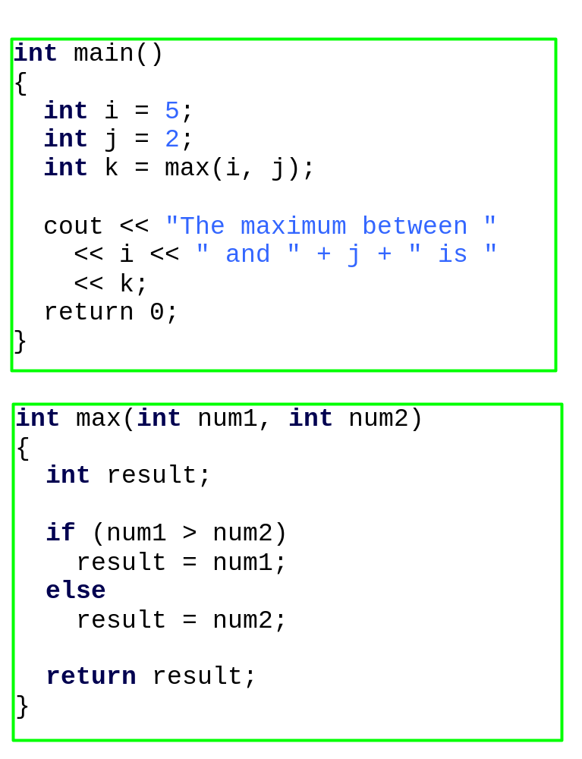

Trace Call Stack
animation
i is declared and initialized

Slide 21
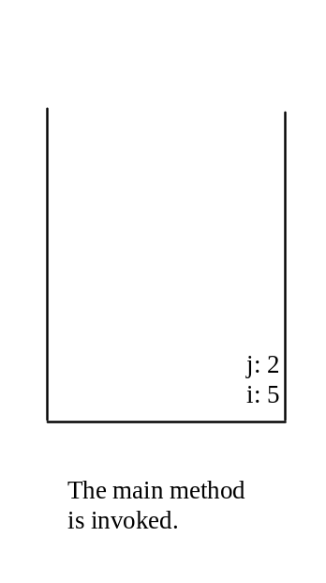
Trace Call Stack
animation
j is declared and initialized

Slide 22
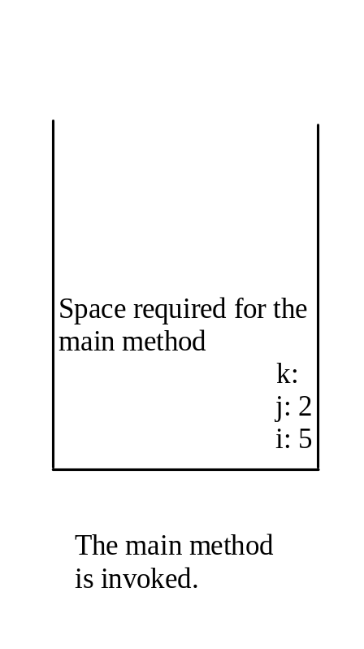
Trace Call Stack
animation
Declare k

Slide 23
Trace Call Stack
animation
Invoke max(i, j)

Slide 24

Trace Call Stack
animation
pass the values of i and j to num1 and num2

Slide 25
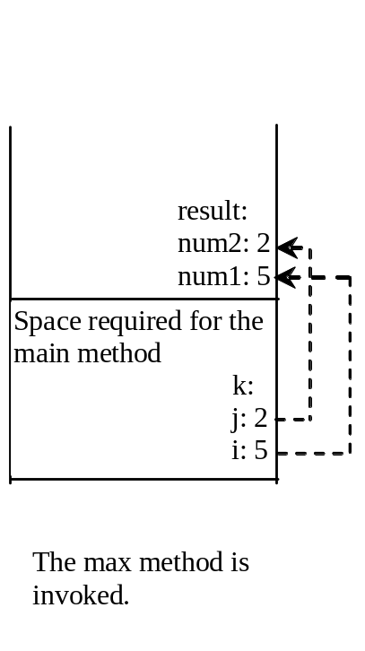
Trace Call Stack
animation
(num1 > num2) is true

Slide 26
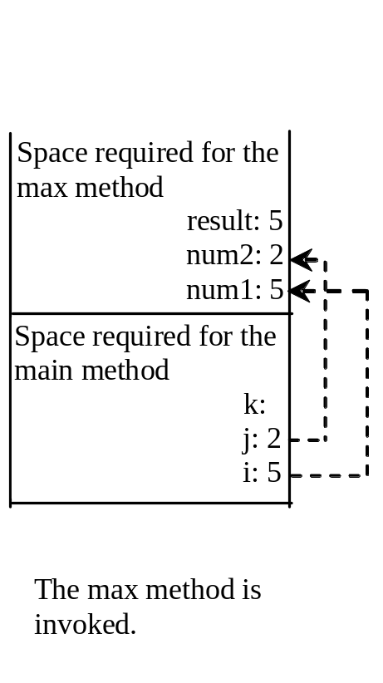
Trace Call Stack
animation
Assign num1 to result

Slide 27

Trace Call Stack
animation
Return result and assign it to k

Slide 28
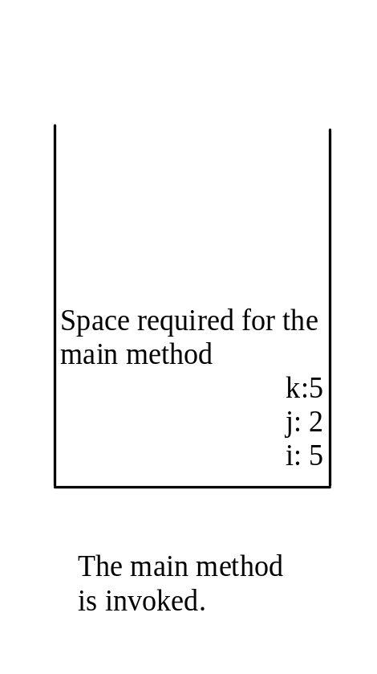
Trace Call Stack
animation
Execute print statement

Slide 29
void Functions
The preceding section gives an example of a nonvoid function. This section shows how to declare and invoke a void function. Listing 5.2 gives a program that declares a function named printGrade and invokes it to print the grade for a given score.
TestVoidFunction

Slide 30
Pass Parameters by Values
When you invoke a function with a parameter, the value of the argument is passed to the parameter. This is referred to as pass-by-value. If the argument is a variable rather than a literal value, the value of the variable is passed to the parameter. The variable is not affected, regardless of the changes made to the parameter inside the function. We will examine an interesting scenario in the following example, in which the parameters are changed in the function but the arguments are not affected.
TestPassByValue

Slide 31
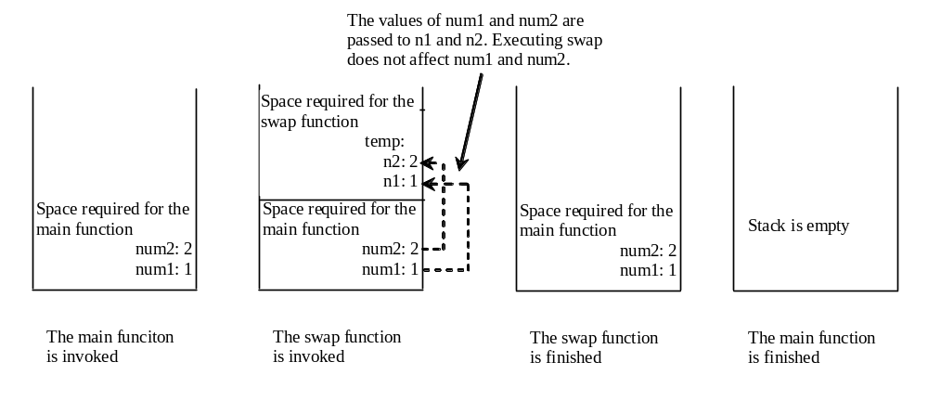
Pass Parameters by Values, cont.

Slide 32
Reference Variables
C++ provides a special type of variable, called a reference variable, which can be used as a function parameter to reference the original variable. A reference variable is an alias for another variable. Any changes made through the reference variable are actually performed on the original variable. To declare a reference variable, place the ampersand (&) in front of the name. For example, see Listing 5.4.
TestReferenceVariable

Slide 33
Pass Parameters By References
You can use a reference variable as a parameter in a function and pass a regular variable to invoke the function. The parameter becomes an alias for the original variable. This is known as pass-by-reference. When you change the value through the reference variable, the original value is actually changed.
Pass-by-value and pass-by-reference are two ways of passing parameters to a function. Pass-by-value passes the value to an independent variable and pass-by-reference shares the same variable. Semantically pass-by-reference can be described as pass-by-sharing.
TestPassByReference

Slide 34
Overloading Functions
The max function that was used earlier works only with the int data type. But what if you need to find which of two floating-point numbers has the maximum value? The solution is to create another function with the same name but different parameters, as shown in the following code:
double max(double num1, double num2)
{
if (num1>num2)
return num1;
else
return num2;
}

Slide 35
Overloading Functions, cont.
If you call max with int parameters, the max function that expects int parameters will be invoked; if you call max with double parameters, the max function that expects double parameters will be invoked. This is referred to as function overloading; that is, two functions have the same name but different parameter lists within one file. The C++ compiler determines which function is used based on the function signature, which consists of the function name and the parameter list.
TestFunctionOverloadin

Slide 36
Ambiguous Invocation
Sometimes there may be two or more possible matches for an invocation of a function, but the compiler cannot determine the most specific match. This is referred to as ambiguous invocation. Ambiguous invocation is a compilation error.

Slide 37
Ambiguous Invocation
#include <iostream>
using namespace std;
int maxNumber(int num1, double num2)
{
if (num1 > num2)
return num1;
else
return num2;
}
double maxNumber(double num1, int num2)
{
if (num1 > num2)
return num1;
else
return num2;
}
int main()
{
cout << maxNumber(1, 2) << endl;
return 0;
}
Notes:
We can change maxNumber(1,2) to maxNumber(1,2.0), it will match the first maxNumber function. So, there will be no compilation errors.

Slide 38
Function Prototypes
As you know, before a variable is used, it must be declared first. Therefore, before a function is called, it must be declared first. One way to ensure it is to place the declaration before all function calls. Another way to approach it is to declare a function prototype before the function is called. A function prototype is a function declaration without implementation. The implementation can be given later in the program.
function prototype=function header + ;
TestFunctionPrototype
Notes:
Function prototype=function header + ;

Slide 39
Default Arguments
C++ allows you to declare functions with default argument values. The default values are passed to the parameters when a function is invoked without the arguments.
DefaultArgumentDemo

Slide 40
Default Arguments, cont.
When a function contains a mixture of parameters with and without default values, the parameters with default values must be defined last. For example, the following declarations are illegal:
void t1(int x, int y=0, int z); // illegal
void t2(int x=0, int y=0, int z); // illegal

Slide 41
Case Study: Computing Taxes with Functions
The program in Listing 3.4, “Computing Taxes,” uses if statements to check the filing status and computes the tax based on the filing status. This example uses functions to simplify Listing 3.4.
Each filing status has six brackets. The code for computing taxes is nearly the same for each filing status except that each filing status has different bracket ranges. For example, the single filer status has six brackets [0, 6000], (6000, 27950], (27950, 67700], (67700, 141250], (141250, 307050], (307050, ∞), and the married file jointly status has six brackets [0, 12000], (12000, 46700], (46700, 112850], (112850, 171950], (171950, 307050], (307050, ∞).

Slide 42
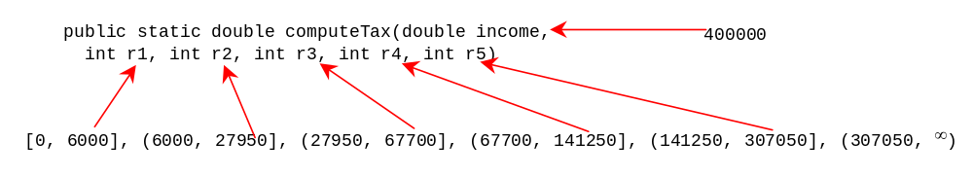
Case Study cont.
The first bracket of each filing status is taxed at 10%, the second 15%, the third 27%, the fourth 30%, the fifth 35%, and the sixth 38.6%. So you can write a Function with the brackets as arguments to compute the tax for the filing status. The signature of the Function is:
For example, you can invoke computeTax(400000, 6000, 27950, 67700, 141250, 307050) to compute the tax for single filers with $400,000 of taxable income:
ComputeTaxWithFunction

Slide 43
Reusing Functions by Different Programs
One of the benefits of functions is for reuse. In the preceding sections, you declared functions and used them from the same program. To make the functions available for other programs to use, you need to place the functions in a separate file, called header file. By convention, the file has a .h extension. Programs use #include preprocessor directives to include header files in order to reuse the functions defined in the header file.
Mylib.h
Mylib.cpp
UseMylib.cpp

Slide 44
Case Study: Generating Random Characters
Computer programs process numerical data and characters. You have seen many examples that involve numerical data. It is also important to understand characters and how to process them.
As introduced in §2.11, every character has a unique ASCII code between 0 and 127. To generate a random character is to generate a random integer between 0 and 127. You learned how to generate a random number in §3.8. Recall that you can use the srand(seed) function to set a seed and use rand() to return a random integer. You can use it to write a simple expression to generate random numbers in any range. For example,

Slide 45
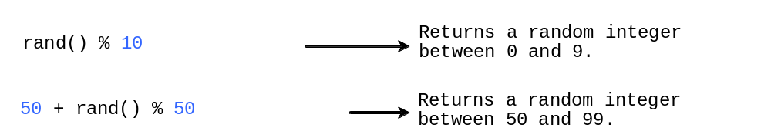
Case Study: Generating Random Characters, cont. (t.b.c. 4.11 )
RandomCharacter.h
TestRandomCharacter

Slide 46
Scope of Variables
The scope of variable is the part of the program where the variable can be referenced.
A variable defined inside a function is referred to as a local variable.
C++ also allows you to use global variables. They are declared outside all functions and are accessible to all functions in its scope.
Local variables do not have default values, but global variables are defaulted to zero.

Slide 47
Scope of Local Variables, cont.
You can declare a local variable with the same name multiple times in different non-nesting blocks in a function, but you cannot declare a local variable twice in nested blocks.

Slide 48
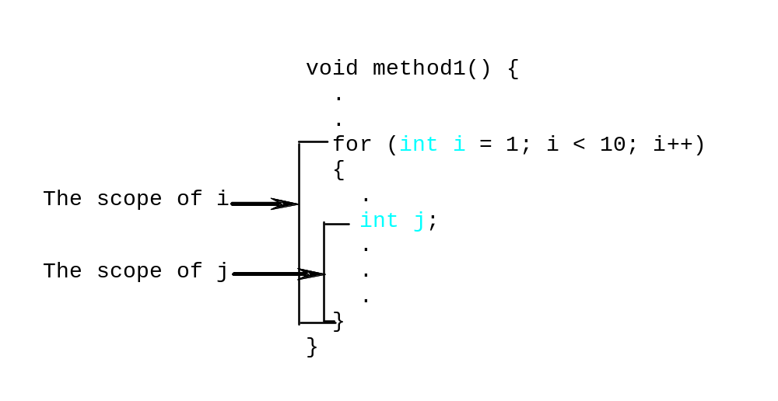
Scope of Local Variables, cont.
A variable declared in the initial action part of a for loop header has its scope in the entire loop. But a variable declared inside a for loop body has its scope limited in the loop body from its declaration and to the end of the block that contains the variable.

Slide 49
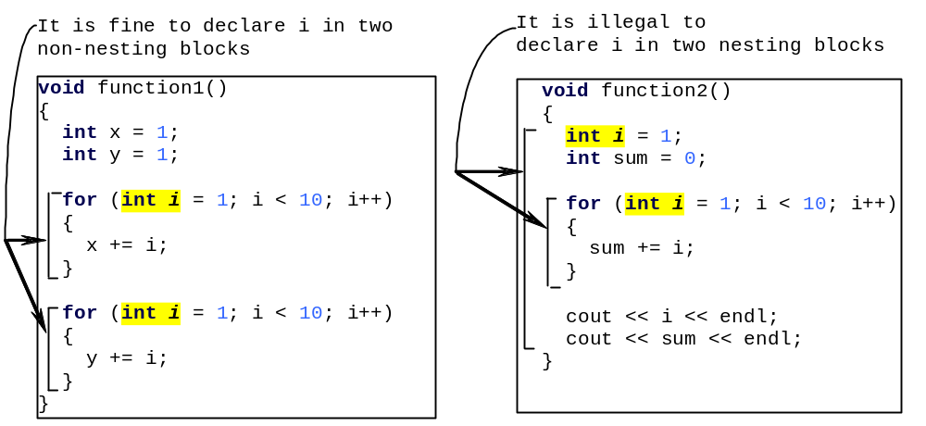
Scope of Local Variables, cont.

Slide 50
Global Variables
C++ also allows you to use global variables. They are declared outside all functions and are accessible to all functions in its scope. Local variables do not have default values, but global variables are defaulted to zero.
VariableScopeDemo

Slide 51
Unary Scope Resolution
If a local variable name is the same as a global variable name, you can access the global variable using ::globalVariable. The :: operator is known as the unary scope resolution. For example, the following code:
#include <iostream>
using namespace std;
int v1 = 10;
int main()
{
int v1 = 5;
cout << "local variable v1 is " << v1 << endl;
cout << "global variable v1 is " << ::v1 << endl;
return 0;
}
Notes:
Unary scope resolution 全域生存空间

Slide 52
Static Local Variables
After a function completes its execution, all its local variables are destroyed. Sometimes, it is desirable to retain the value stored in local variables so that they can be used in the next call. C++ allows you to declare static local variables. Static local variables are permanently allocated in the memory for the lifetime of the program. To declare a static variable, use the keyword static.
StaticVariableDemo

Slide 53
Inline Functions
Implementing a program using functions makes the program easy to read and easy to maintain, but function calls involve runtime overhead (i.e., pushing arguments and CPU registers into the stack and transferring control to and from a function). C++ provides inline functions to avoid function calls. Inline functions are not called; rather, the compiler copies the function code in line at the point of each invocation. To specify an inline function, precede the function declaration with the inline keyword, as shown in Listing 5.18.
InlineDemo

Slide 54
Short Functions
Not for long Functions
Compiler Decision
Inline functions are desirable for short functions, but not suitable for long functions that are called in multiple places in a program, because long inline functions will dramatically increase the executable code size when it is copied in multiple places. For this reason, C++ allows the compilers to ignore the inline keyword if the function is too long. So, the inline keyword is merely a request to the compiler, and it is up for the compiler to make the decision whether to honor it or ignore it.

Slide 55

Function Abstraction
You can think of the Function body as a black box that contains the detailed implementation for the Function.

Slide 56
Benefits of Functions
Write a Function once and reuse it anywhere.
Information hiding. Hide the implementation from the user.
Reduce complexity.

Slide 57
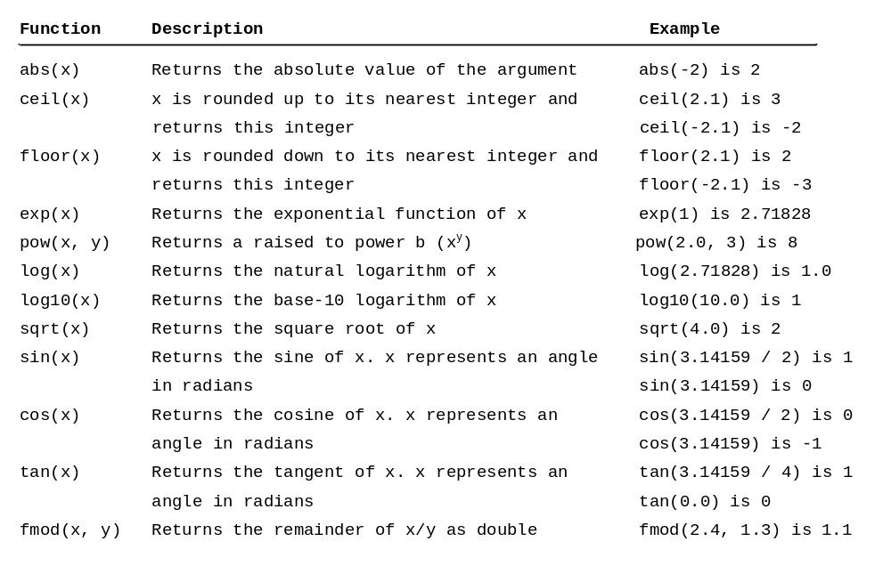
Math Functions

Slide 58
Stepwise Refinement
The concept of Function abstraction can be applied to the process of developing programs. When writing a large program, you can use the “divide and conquer” strategy, also known as stepwise refinement, to decompose it into subproblems. The subproblems can be further decomposed into smaller, more manageable problems.
PrintCalendar

Slide 59
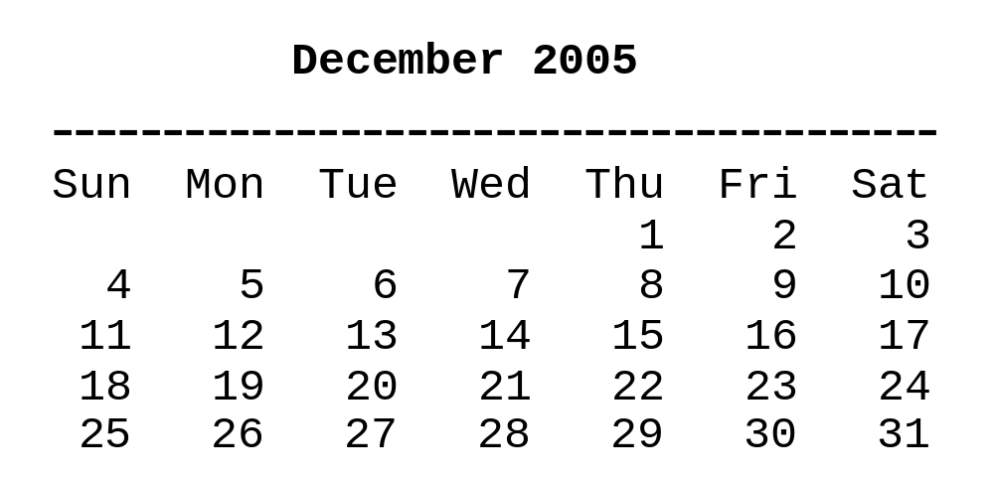
PrintCalender Case Study
Let us use the PrintCalendar example to demonstrate the stepwise refinement approach.

Slide 60

Design Diagram

Slide 61
Implementation: Top-Down
Top-down approach is to implement one Function in the structure chart at a time from the top to the bottom. Stubs can be used for the Functions waiting to be implemented. A stub is a simple but incomplete version of a Function. The use of stubs enables you to test invoking the Function from a caller. Implement the main Function first and then use a stub for the printMonth Function. For example, let printMonth display the year and the month in the stub. Thus, your program may begin like this:

Slide 62
Implementation: Bottom-Up
Bottom-up approach is to implement one Function in the structure chart at a time from the bottom to the top. For each Function implemented, write a test program to test it. Both top-down and bottom-up Functions are fine. Both approaches implement the Functions incrementally and help to isolate programming errors and makes debugging easy. Sometimes, they can be used together.

Slide 63
Chapter Summary
Making programs modular and reusable is one of the central goals in software engineering. C++ provides many powerful constructs that help to achieve this goal. Functions are one such construct.
The function header specifies the return value type, function name and parameter list.

Slide 64
Chapter Summary
A function may return a value. The return value type is the data type of the value that the function returns. If the function does not return a value, the return value type is the keyword void.
The parameter list refers to the type, order and the number of the parameters of a function. The function name and the parameter list together constitute the function signature. Parameters are optional; that is, a function may contain no parameters.

Slide 65
Chapter Summary
A return statement also can be used in a void function for terminating the function and returning the function’s caller. This is useful occasionally for circumventing the normal flow of control in a function.
The arguments that are passed to a function should have the same number, type, and order as the parameters in the function definition.
Notes:
Circumvent 规避

Slide 66
Chapter Summary
C++ supports two ways of passing parameters: pass-by-value and pass-by-reference. Pass-by-value is to pass the value of the argument to the parameter. Pass-by-reference is to pass the reference of the argument.
When a program calls a function, program control is transferred to the called function. A called function returns control to the caller when its return statement is executed or when its function ending closing brace is reached.
Notes:
Circumvent 规避

Slide 67
Chapter Summary
Each time a function is invoked, the system stores its arguments, local variables and system registers in a space known as stack. When a function calls another function, the caller’s stack space is kept intact, and new space is created to handle the new function call. When a function finishes its work and return to its caller, its associated space is released.
A function can be overloaded. This means that two functions can have the same name as long as their function parameter lists differ.
Notes:
Circumvent 规避

Slide 68
Chapter Summary
The scope of a variable is the part of the program where the variable can be referenced. C++ has global variables, local variables and static variables. Global variables are defined outside all functions and are accessible to all functions in its scope. Local variables are defined inside a function. After a function completes its execution, all of its local variables are destroyed. Static local variables can be defined to retain the local variables to be used by the next function call.
Notes:
Circumvent 规避

Slide 69
Chapter Summary
Function abstraction is achieved by separating the use of a function from its implementation. The client can use a function without knowing how it is implemented. The details of the implementation are encapsulated in the function and hidden from the client who invokes the function. This is known as information hiding or encapsulation.
Function abstraction modularizes programs in a neat, hierarchical manner. Programs written as collections of concise functions are easier to write , debug, maintain, and modify than would otherwise be the case. This writing style also promotes function reusability.
Notes:
Circumvent 规避

